Slide 1
Task Mapping in Soft Heterogeneous Systems
Lecture
Course
term

Slide 2
The Rise of Heterogenous Computing

Slide 3

Processor on a Board

Slide 4
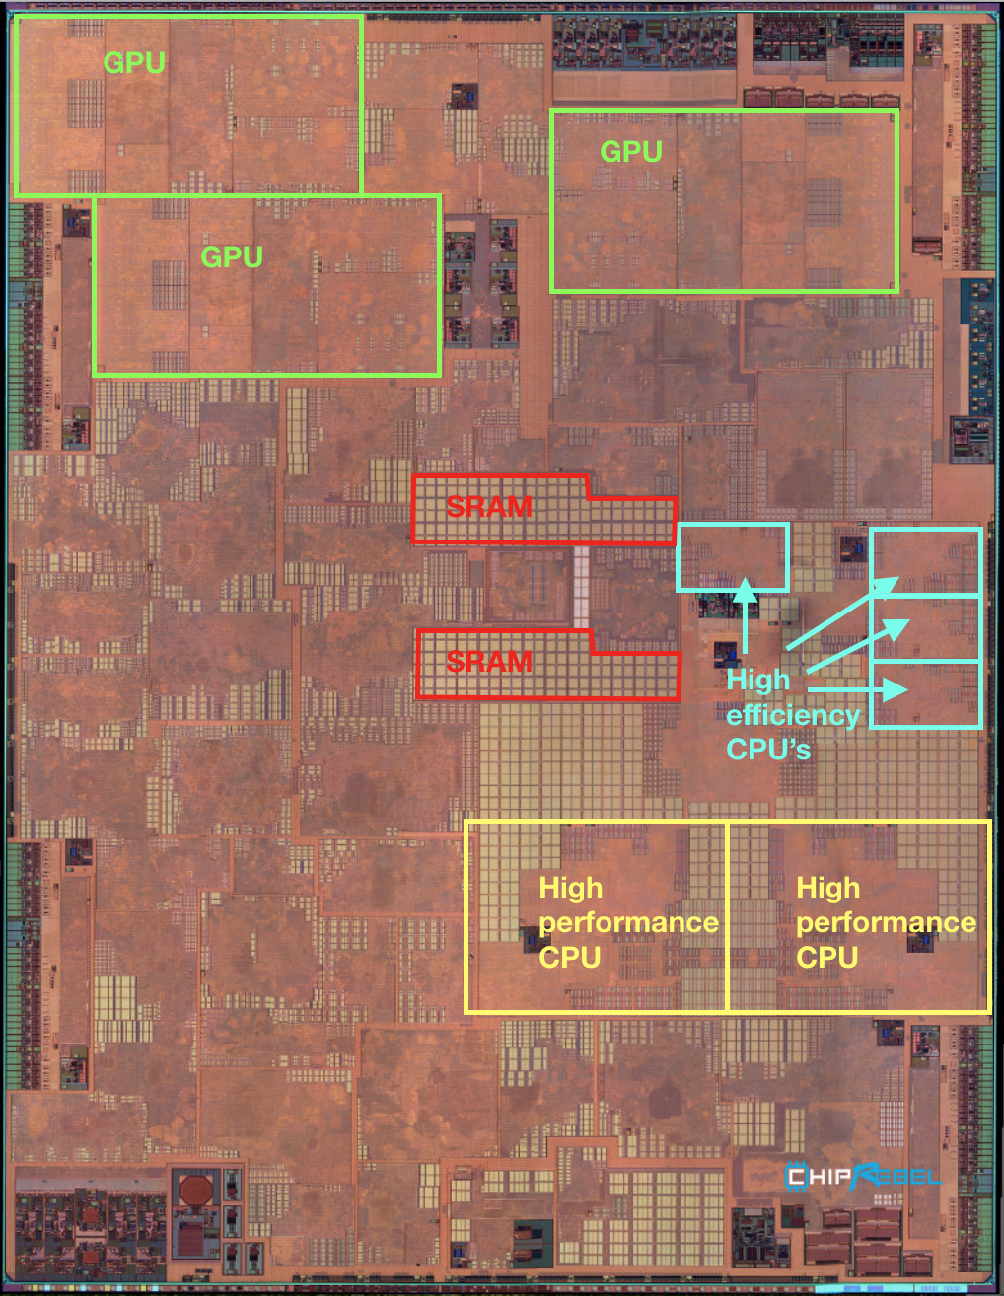
Heterogenous Processors
Notes:
Why do we want to have different kinds of processors on a phone?
What is your typical usage? What apps do you have running on your phone?
Can someone share the apps they currently have running (in the background)?
Introduce the notion of a workload.
A bunch of apps with different characteristics and different demands for resources.

Slide 5
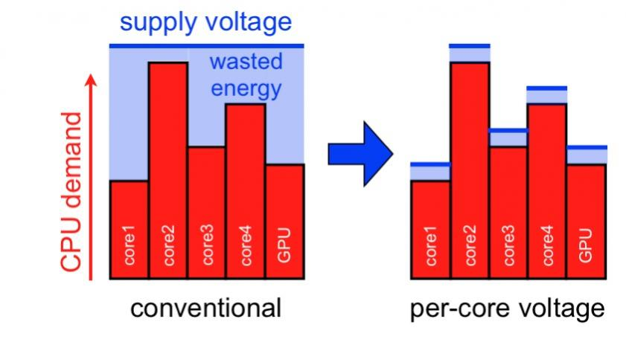
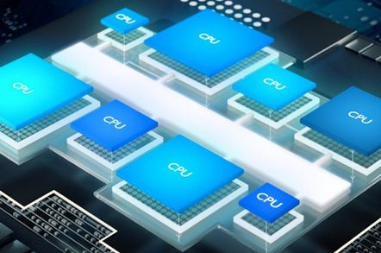
“Soft” Heterogeneity
Fat and Thin Cores
DVFS
image: SemiWiki

Slide 6

von-Neuman is Evolving
Computer

Slide 7
ARM Big-Little Architecture
Notes:
Add diagram

Slide 8
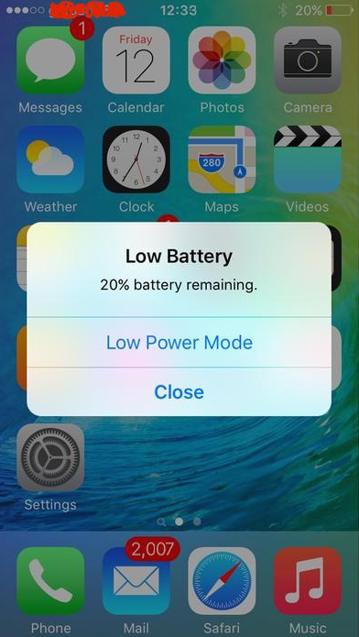
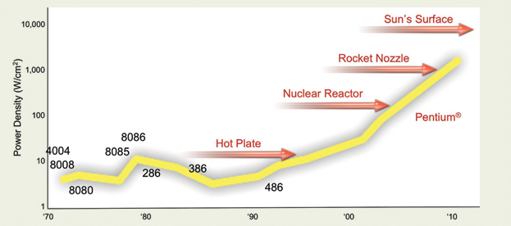
Computing is not just about performance
Chart courtesy : Pat Gelsinger, Intel Developer Forum, 2004

Slide 9

Soft Heterogeneity
Heterogenous Multicore System
Operational frequency is different
Notes:
Introduce notion of clock frequency and it’s impact on performance (CS1 students will generally know this)
What is your consideration when buying a new laptop?
lead discussion towards processing speed/ clock rate
Why do you care about clock rate?
Processors can operate at frequencies other than the one advertised.
Any one familiar with the term overclocking?
we expect some CS1 students to be already familiar with at at least the term
Similarly, we can also “underclock” a processor
Why might we want to run a processor at lower frequency?
Alternatively, why not overclock all the time?

Slide 10
Task Mapping and Scheduling

Slide 11
Task Scheduling on Sequential Processors
OS interrupt
Context switch
OS interrupt
Context switch
process 1
process 2
process 1
running
running
running I/O completion
system call for I/O
OS interrupt
Context switch
process 1
process 2
process 1
running
running
running I/O completion
system call for I/O
11

Slide 12
Task Scheduling on Parallel Processors
OS interrupt
Context switch
OS interrupt
Context switch
process 1
process 2
process 1
running
running
running I/O completion
system call for I/O
OS interrupt
Context switch
process 1
process 2
process 1
running
running
running I/O completion
system call for I/O
12

Slide 13
Task Mapping and Thread Affinity

Slide 14
Task Mapping on Heterogeneous Parallel Systems
Goal is to bind tasks to cores that best matches its requirements
If a task is computation-heavy set it’s affinity to the core with the highest frequency

Slide 15
Demo: Task Mapping

Slide 16
Reference
image source
von Neumann, Amdahl: wikipedia.org
Amdahl’s Law Scalability: wikipedia.org
AMD Opteron: amd.com
Intel Core i7: intel.com
Programmer mem: pinterest.com
Nvidia Pascal: nvidia.com

